Slide 1
EMBRACING THE FUTURE: NURTURING THE HEALTH OF OUR LITTLE HEROES

Slide 2

INTRODUCTION
Welcome to the presentation on Embracing the Future: Nurturing the Health of Our Little Heroes.
Today, we will explore innovative approaches to prioritize the well- being of our children. By empowering them with healthy
habits and cutting-edge technologies, we can ensure a
brighter future for the next generation.

Slide 3

THE POWER OF PREVENTION
Prevention is the key to a healthier future. By promoting regular exercise, balanced nutrition, and mental well-being, we can lay a strong foundation for our little heroes. Let's empower them to make informed choices and create a world where healthy habits are the norm.

Slide 4
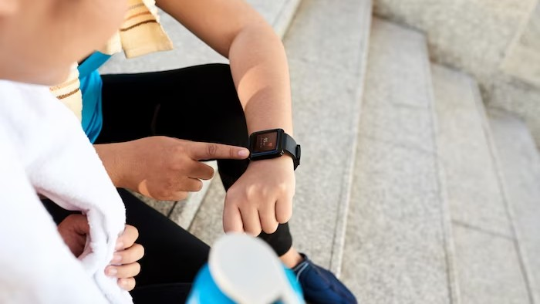
Embracing Technology for Health
In this digital era, we have an incredible opportunity to leverage technology for the well-being of our children. From wearable fitness trackers to health monitoring apps, let's explore how these advancements can empower our little heroes to take charge of their health and embrace a future full of possibilities.

Slide 5
CONCLUSION
As we conclude this presentation, let's remember that the health of our little heroes is in our hands. By fostering a culture of health promotion and innovation, we can create a world where every child thrives. Together, let's embrace the future and nurture the health of our little heroes, ensuring a brighter tomorrow for all.

Slide 6

Thanks!
Do you have any questions? youremail@freepik.com
+91 620 421 838
yourcompany.com

